Slide 1

Sampling Distributions
PsychoStat

Slide 2

Sampling Distributions
Goal: We want to describe some characteristic of our group of interest
Quantified through a population parameter (e.g. Population Mean/Average = ?)
Action: We collect data from a sample drawn from our population of interest
Calculate sample statistics to estimate the population parameters (e.g. Sample Mean = 6)
Problem: The sample results that we get are partly a function of sampling error
If we collect data from multiple samples from the same population, the results will vary
Implication: Are our results informative about the population or just due to sampling variability?
How do we separate the signal from the noise?

Slide 3

Example
Goal: We are interested in determining the average hours of sleep per night for U.S. college students
Our hypothesis is that U.S. college students get 7 hours of sleep per night on average
$H_{0}: μ=7 hours$
Action: We collect sample data from 157 college students who respond to a survey about their sleep habits
The average number of hours of sleep per night for the students in our sample is 6.3 hours per night
$\overline{X}=6.3 hours$
Problem: We decide to repeat our study 3 more times and we get different sample averages every time!
${\overline{X}}_{1}=6.3 hours, {\overline{X}}_{2}=5.2 hours, {\overline{X}}_{3}=9.2 hours, {\overline{X}}_{4}=4.6 hours$
Question: If we only have access to one sample, how do we know whether our result is actually meaningful?
We can use sampling distributions to determine what degree of sample-to-sample variability is reasonable

Slide 4
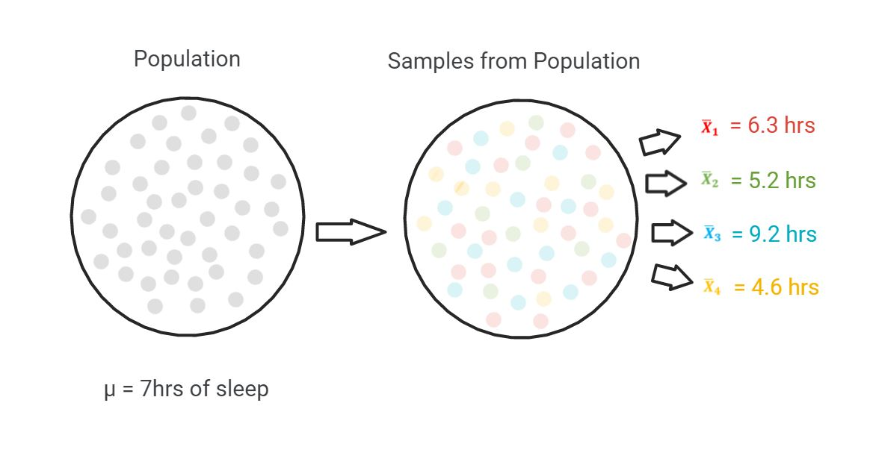

Slide 5
Sampling Distributions
Concept: Imagine drawing samples of a certain size over and over from a given population
For each sample that we draw, we calculate a sample statistic and record its value
The distribution of these sample statistic values is our sampling distribution
Thought: Whenever you hear “sampling distribution”, think “distribution of sample statistics”
All of the values we might expect to get for a sample statistic if we sampled a bajillion times
Example: If we drew an infinite number of samples from the population of all college students
For each of those samples, we calculate the average hours of sleep per night
The sampling distribution is comprised of all of those sample averages

Slide 6
Why Do We Care?
Main Idea: The sampling distribution (distribution of sample statistics) tells us what values are within reason for a sample that was drawn from a given population
Which sample statistic values we might reasonably expect to see when sampling from a certain population
Importance: If we have a hypothesis about what we think the population characteristics are, the sampling distribution can help us determine what sample statistic values would be within reason
If we only have a single sample and sample statistic, we can compare it to the sampling distribution
This can tell us the probability of getting such a value if the sample really was drawn from the hypothesized population
Sampling distributions help us evaluate the likelihood that our sample came from a given population
Example: We compare our sample average of 6.3 to the distribution of sample means for a population with a mean of 7
We observe that 95% of the sample means are expected to fall between 6.5 hrs and 7.5 hrs
There is only a very low probability of getting a sample mean as far away from the population mean as ours if the sample really came from this population

Slide 7
Next Steps
We now understand why sampling distributions are useful, but how do we calculate them?
We can’t really just draw samples over and over and over and calculate an infinite number of sample statistics from every population that we’re interested in…
Luckily, statistical theory tells us about the expected characteristics of various sampling distributions under certain conditions
Enter the Central Limit Theorem…

